Slide 1
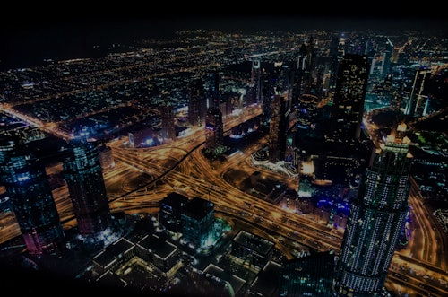
Title Slide
Smart Cities: Technology for Urban Development
Priyanshu rana
Date
Institution/Organization (if applicable)

Slide 2
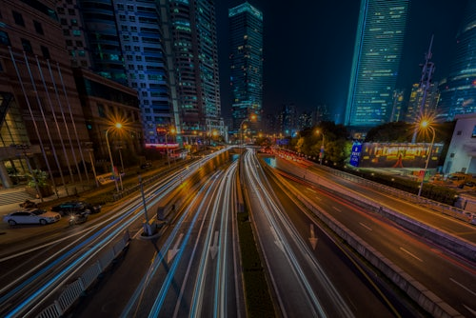
Introduction
What is a Smart City?
Importance of smart cities in the 21st century
Rising urban population and growing challenges

Slide 3

Core Technologies in Smart Cities
Internet of Things (IoT)
Big Data & Analytics
Artificial Intelligence (AI)
5G Connectivity

Slide 4
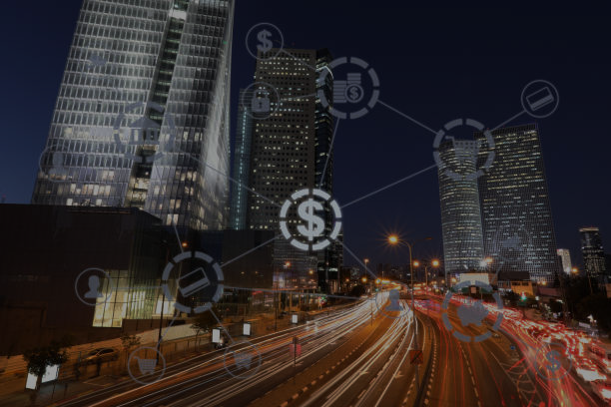
Smart Infrastructure
Smart buildings and utilities
Structural health monitoring
Green architecture

Slide 5
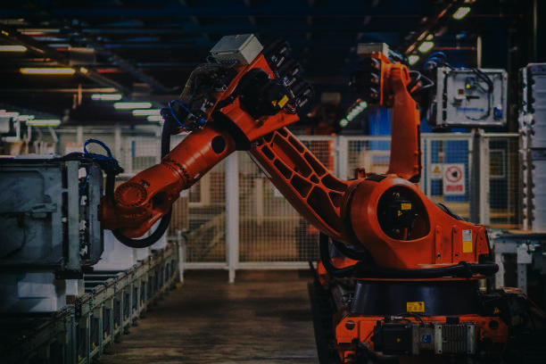
Intelligent Transportation Systems
Adaptive traffic signals
Smart parking solutions
Real-time public transport updates
Autonomous vehicles

Slide 6

Smart Energy and Environment
Smart grids
Renewable energy integration
Smart meters
Pollution monitoring

Slide 7

Digital Governance & Citizen Services
e-Government platforms
Mobile service apps
Transparent governance
Civic engagement tools

Slide 8
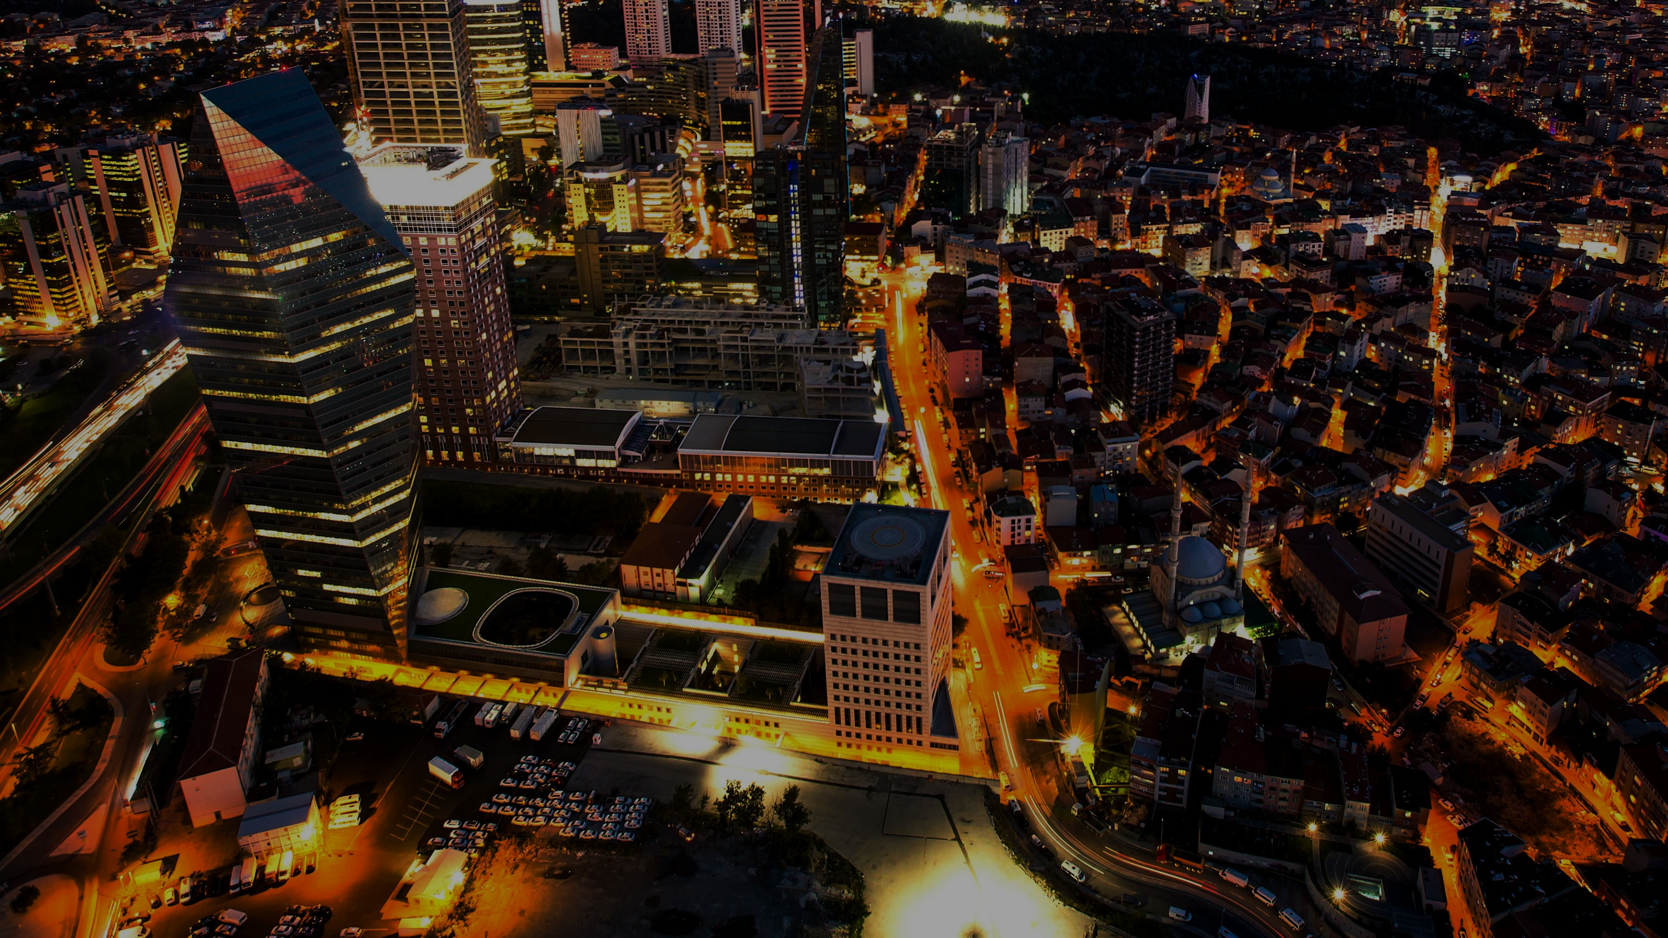
Benefits of Smart Cities
Efficient resource use
Improved public safety
Economic growth
Higher quality of urban life

Slide 9

Challenges and Risks
Data privacy and cybersecurity
Digital divide
High initial investment
Interoperability between systems

Slide 10

Case Studies
Singapore – Smart Nation initiative
Barcelona – Urban mobility solutions
Amsterdam – Sustainability projects

Slide 11

Future of Smart Cities
AI and robotics
Urban digital twins
Sustainable city planning
Citizen-centered innovation

Slide 12
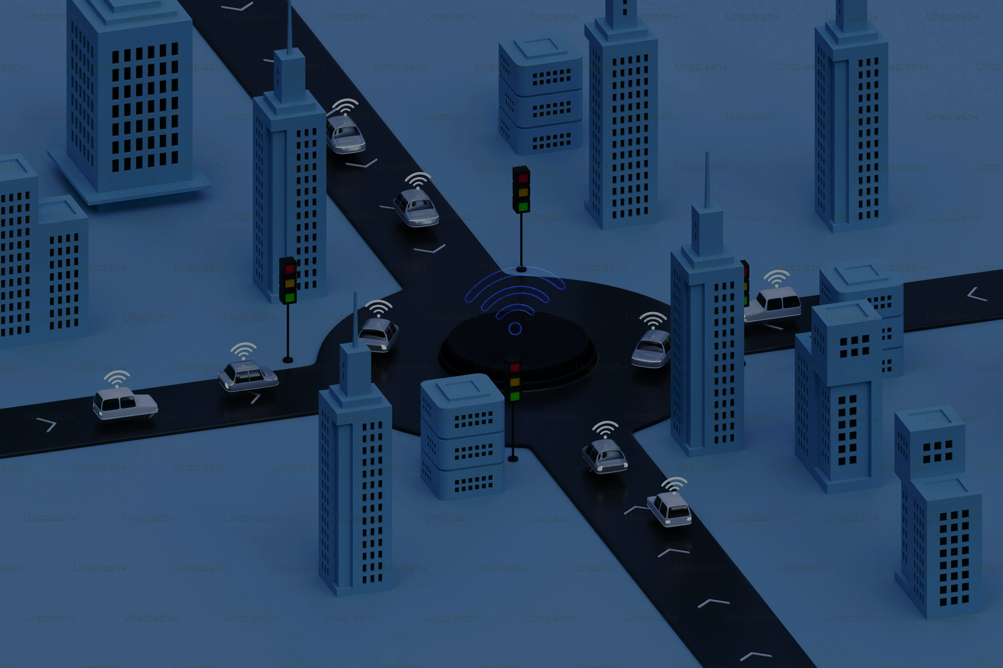
Conclusion
Summary of key points
The path forward: innovation with responsibility
Final thought or quote on urban development

